Slide 1

B.TECH training &internship
- Sonal diwan
Subtitle:
Machine Learning Training and
learning program
Details
Sonal Diwan, 42160
PRN No.: 2021141242115

Slide 2
Overview of the internship program
Comprehensive initiative for in-depth knowledge and practical experience in machine learning.

Slide 3

Company overview
FOX-TARDING
PLATFORM -1STOP.AI

Slide 4


Modules in training
PYTHON AND DIFFERENT LIBRARIES
1
2
STATISTICS AND MACHINE LEARNING CONCEPTS
3
DIFFERENT PROJECTS
Bike sharing demand project
Stock market Prediction
This Photo by Unknown Author is licensed under CC BY-SA-NC

Slide 5






Tools used

Slide 6
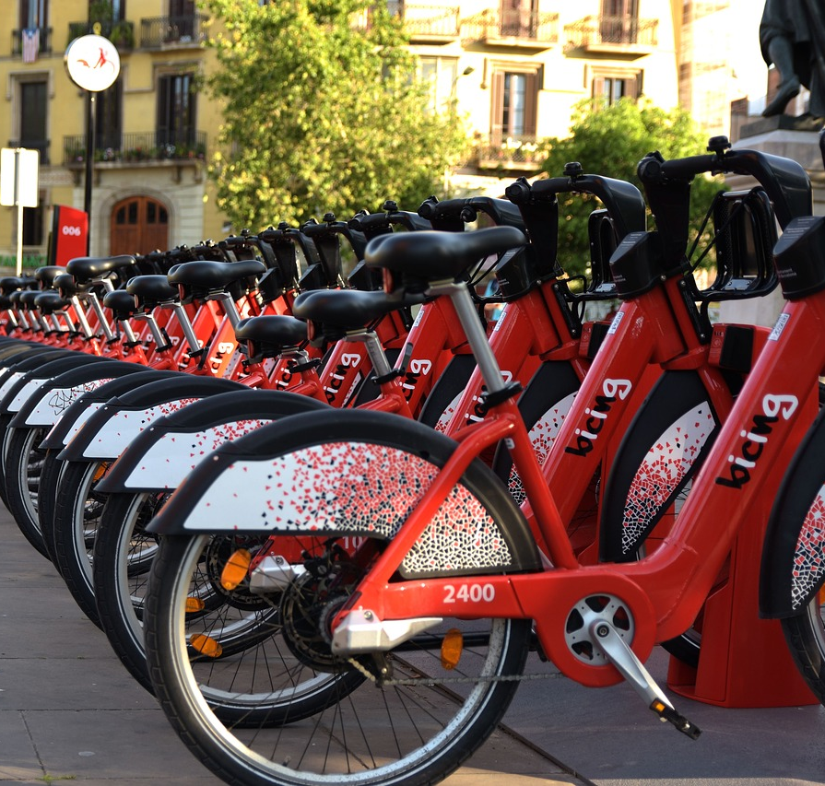
BIKE SHARING DEMAND PREDICTION
Project Overview

Slide 7

Solution and methodology
Data preprocessing
model tuning and optimization,
model selection
feature engineering
model training & evaluation,
exploratory data analysis,
This Photo by Unknown Author is licensed under CC BY

Slide 8
CONCLUSION OF PROJECT
Data Preparation
Model performance
Feature importance
Model Evaluation
Hour of the day, day of week,
Weather related features – temperature ,
Humidity, ..
Random forest regressor > Gradient boosting regressor > Linear regressor

Slide 9
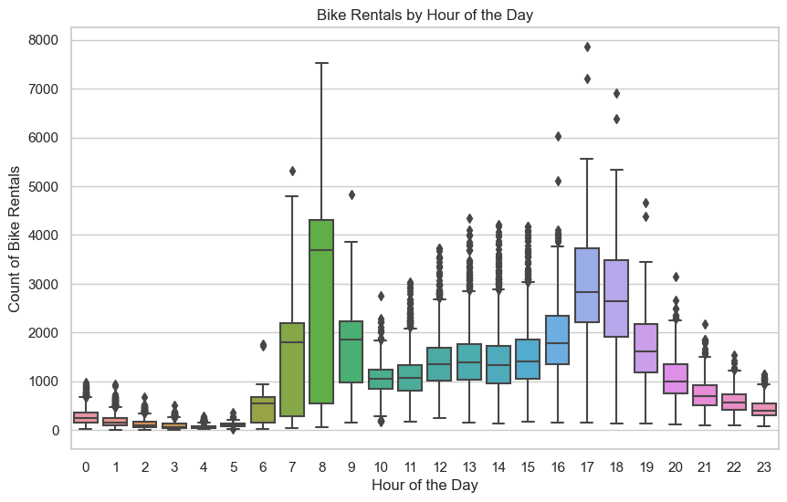
DATA VISUALIZATION
Forecasting for success​

Slide 10
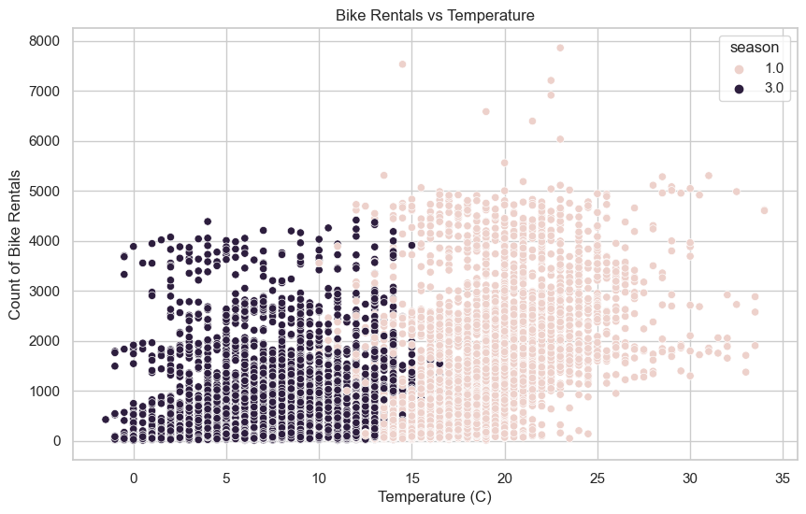
DATA VISUALIZATION
Forecasting for success​

Slide 11
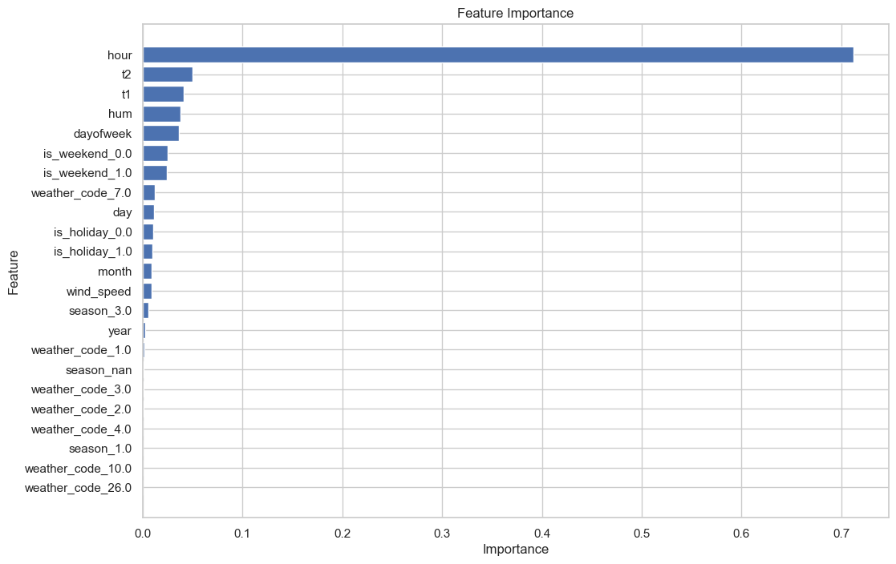
DATA VISUALIZATION
Forecasting for success​

Slide 12

Stock market prediction
Using LSTModel and yfinanace library

Slide 13

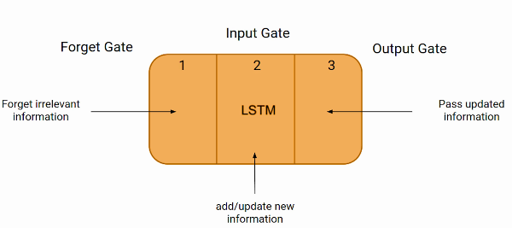
LSTM MODEL

Slide 14
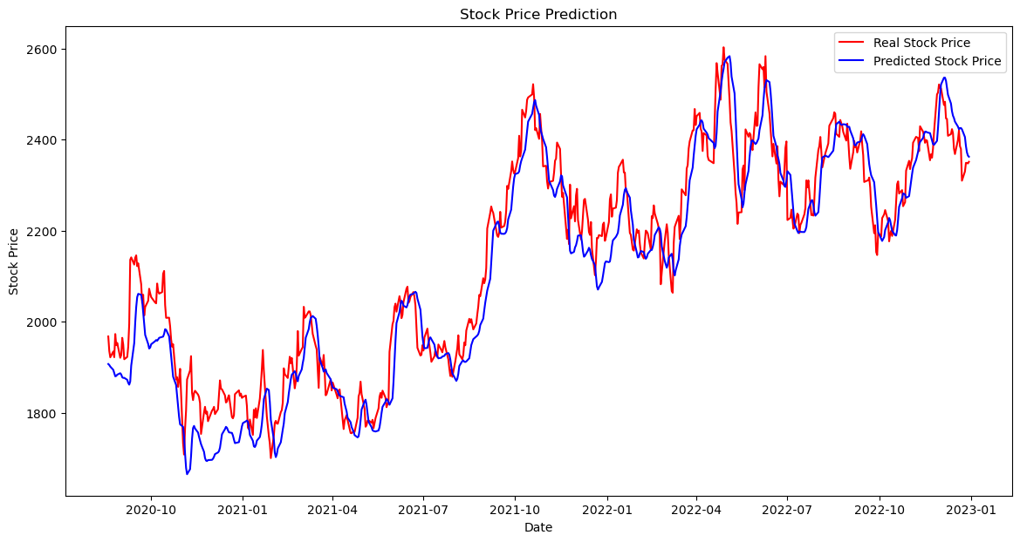

Slide 15

Learning Outcome
Proficiency in python
Application of libraries
Problem solving skills
Understanding machine learning
Continuous learning and
Using and practising different tools

Slide 16

Summary
Contribution to sustainable mobility,
Practical applications,
Potential improvements.

Slide 17

Thank you
SONAL DIWAN
+91 7240533214​
sonalsanajydiwan777@gmail.com
Git link - https://github.com/SONA0007/BikeSharingDemand

